Slide 1
Stock Price Prediction using Machine Learning
By Abhiram G, Adithya N, B Likeith, Datta Shashank C

Slide 2
Introduction
Predicting stock prices using machine learning helps predict the future value of stocks and other financial assets of companies traded on the stock exchange. There are factors involved in prediction, such as physical and psychological factors, rational and irrational behavior. All of these factors combine to make stock prices dynamic and volatile. Therefore, accurate stock price forecasts are extremely difficult due to multiple factors such as politics, global economic conditions, unexpected events, and corporate performance.
All this also means that there is a lot of data for which patterns can be found. Therefore, financial analysts, researchers, and data scientists continue to seek analytical methods to identify stock market trends. This gave rise to the concept of algorithmic trading, which executes orders using automated and pre-programmed trading strategies.

Slide 3
Workflow Diagram
Time Series forecasting & modelling plays an important role in data analysis. Time series analysis is a specialized branch of statistics used extensively in fields such as Econometrics & Operation Research. Time Series is being widely used in analytics & data science.
Stock prices are volatile in nature and price depends on various factors. The main aim of this project is to predict stock prices using Long short-term memory (LSTM) model.
In this project our task is to predict stock prices to help investors predict stock prices to aid their investments. We use the open, high, low and close prices from the datasets to predict the price of a stock.
The prediction of the stocks can be viewed on the website. Prices and graphs of various stocks can be found on the website. The price from a certain period of time can also be predicted using the model.

Slide 4
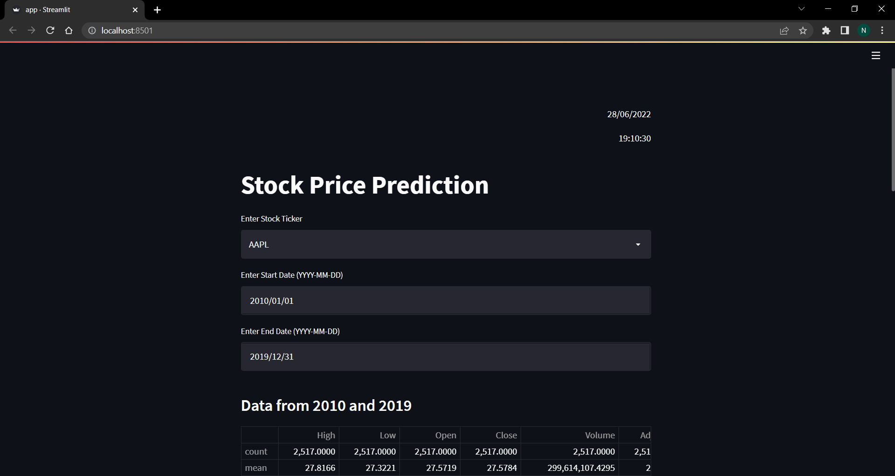
Screenshots

Slide 5
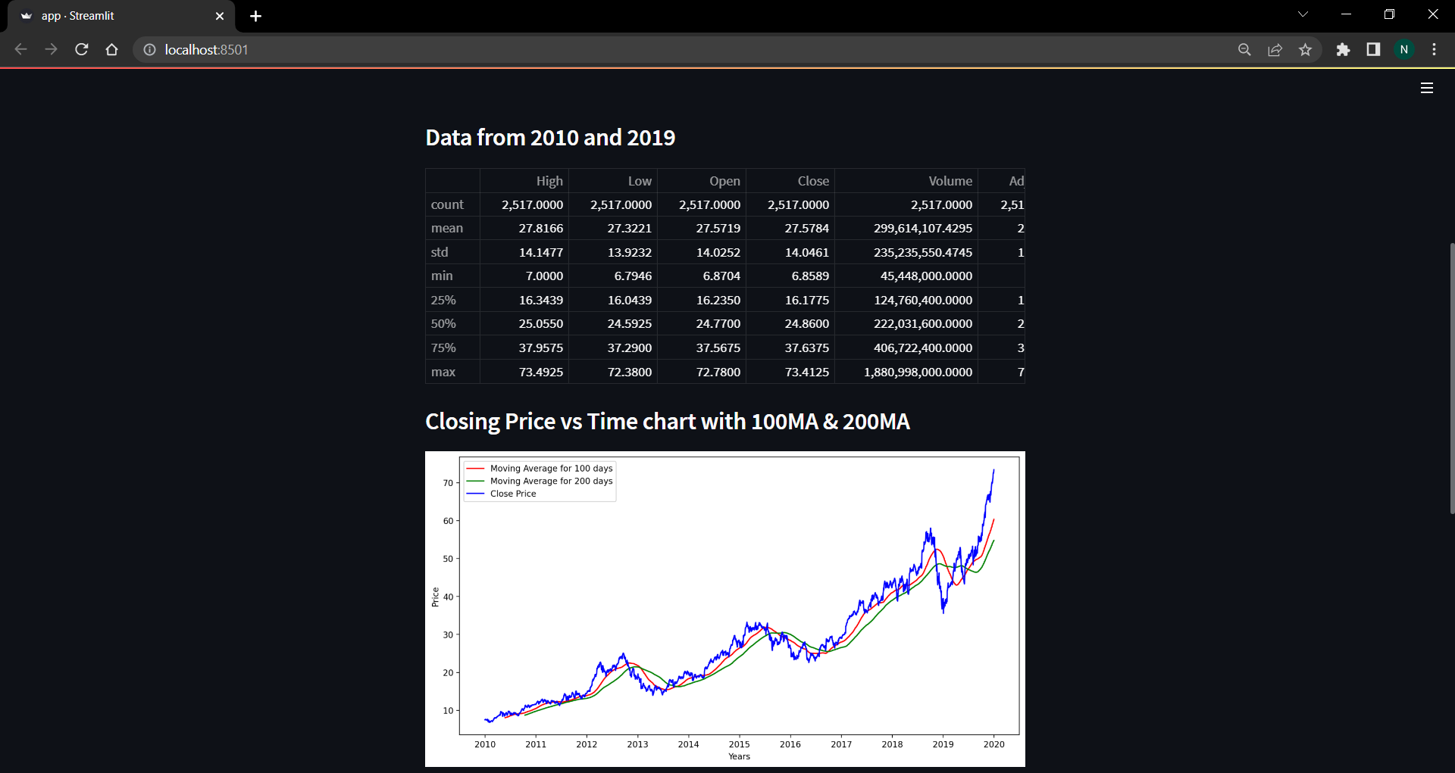
Screenshots

Slide 6
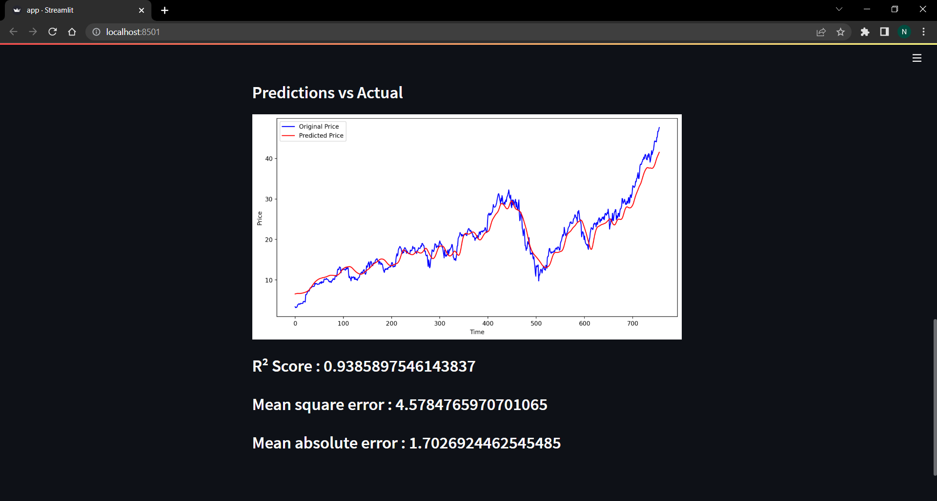
Screenshots

